Slide 1
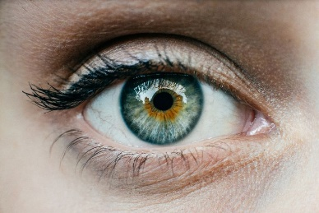
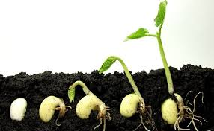




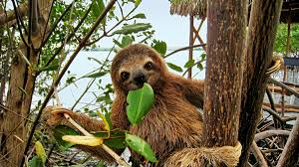
Questions 1 & 2
MR GREEN
Move to find the resources they need
Respond to changes in their environment
Grow as they get older
Reproduce to make new individuals
Excrete waste products from their bodies
Exchange gases with their environment
Nutrition from food and water
Vocabulary
Characteristic: feature or quality

Slide 2
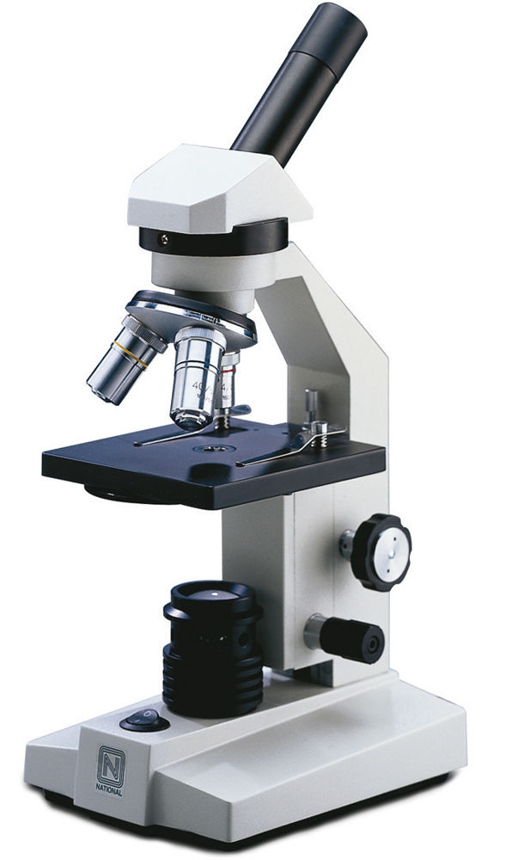
Question 3
Parts of a Microscope - Lenses
A lens magnifies an image
There are two lenses in a microscope:
Eyepiece lens – the one you look through
Objective lens – the one nearest the object
Parts of a Microscope - Focusing
There are two focus knobs on a microscope:
Coarse focus – brings the sample into general focus
Fine focus – fine tunes the focus, increases the detail in the image
Vocabulary
Magnify: make small objects look bigger

Slide 3
Question 4 & 5
Parts of a Microscope – Looking at slides
Samples are put on a thin piece of glass called a slide
The stage – holds the slide
Light – shines light through the sample
Parts of a Microscope - Support
Some parts are there to support others
Arm – supports the lenses
Base – supports the microscope and holds the light
Vocabulary
Focusing: making an image clear

Slide 4
Question 6
Using a Microscope
1. Carry the microscope with two hands.
2. Place the microscope on a flat surface.
3. Make sure the smallest objective lens is in place.
4. Lower the stage and put the slide on it.
5. Looking from the side, raise the stage to the top
6. Look through the eyepiece lens and turn the coarse focus knob until you see an image
7. Use the fine focus knob to sharpen the image
Vocabulary
Focusing: making an image clear

Slide 5
Question 7
Cells are made up of organelles, which are smaller parts of the cell, each one having a different function.
All cells have four key features: Cell membrane, vacuole, cytoplasm, DNA
Cell membrane - The cell membrane forms a barrier around the cell
Vacuole – contains waste or chemicals
Cytoplasm – Fluid inside the cell that provides structure and contains smaller parts of the cell
DNA – (deoxyribonucleic acid) – provides the instructions for every job the cell needs to do and is passed from one generation to the next. DNA is found in the nucleus.
Nucleus – contains the DNA of the cell

Slide 6
Question 8
Each organelle has a special function.
Mitochondria – releases energy from food
Ribosomes – produces proteins used by the body for growth and repair
Lysosomes – gets rid of waste from the cell
Endoplasmic reticulum – allows materials to move through the cell
Golgi body – packages proteins inside the cell before they are sent to their destination

Slide 7
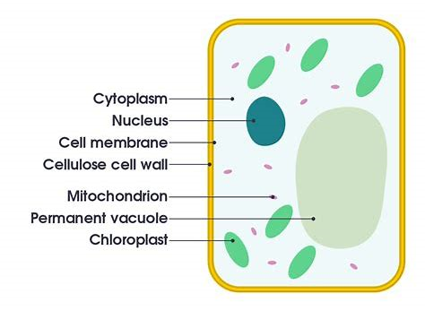
Question 9
Plants have the same parts as animal cells, plus a few extra.
Cell wall – exists outside the cell membrane, supports and protects the cell
Chloroplasts - Contain chlorophyll to photosynthesise.
Notes:
Plant cell

Slide 8
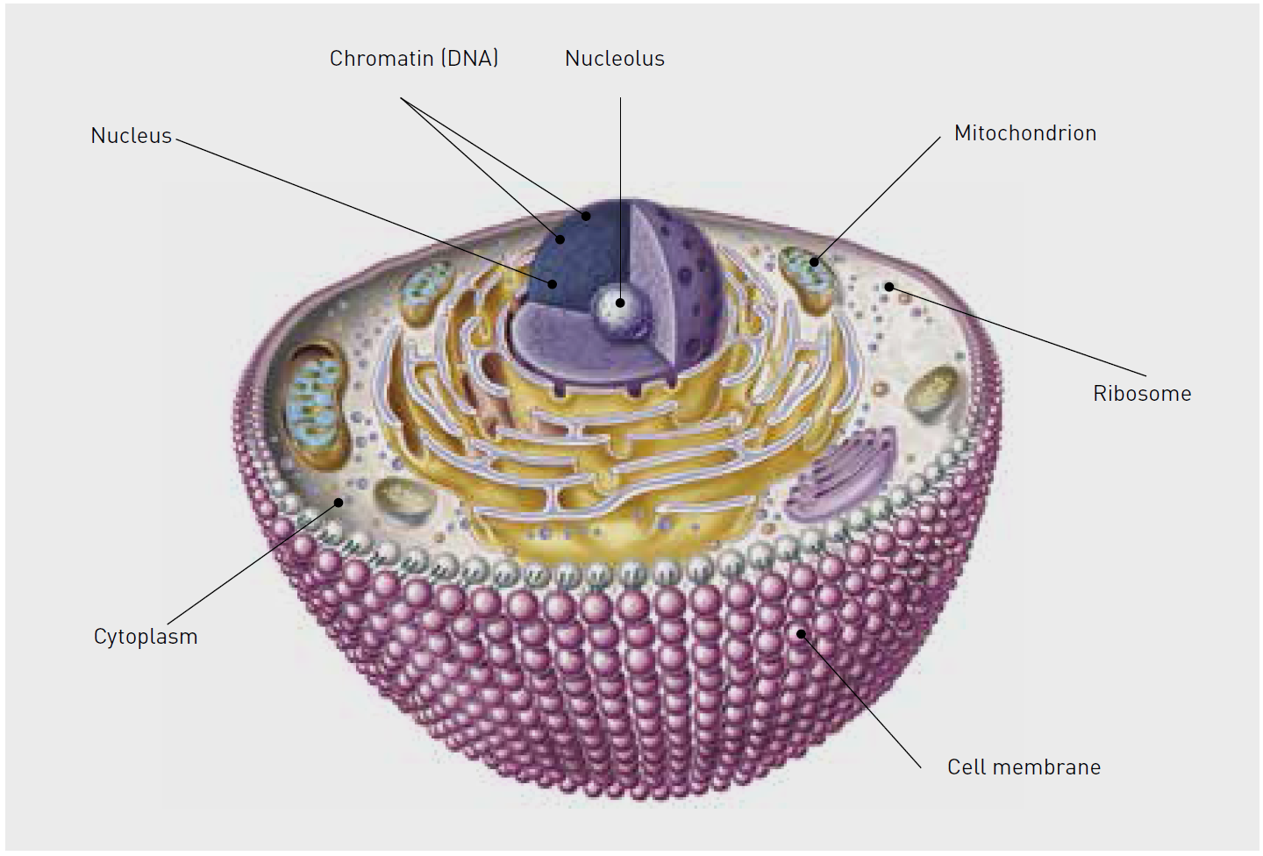
Question 10
Notes:
Animal Cell

Slide 9
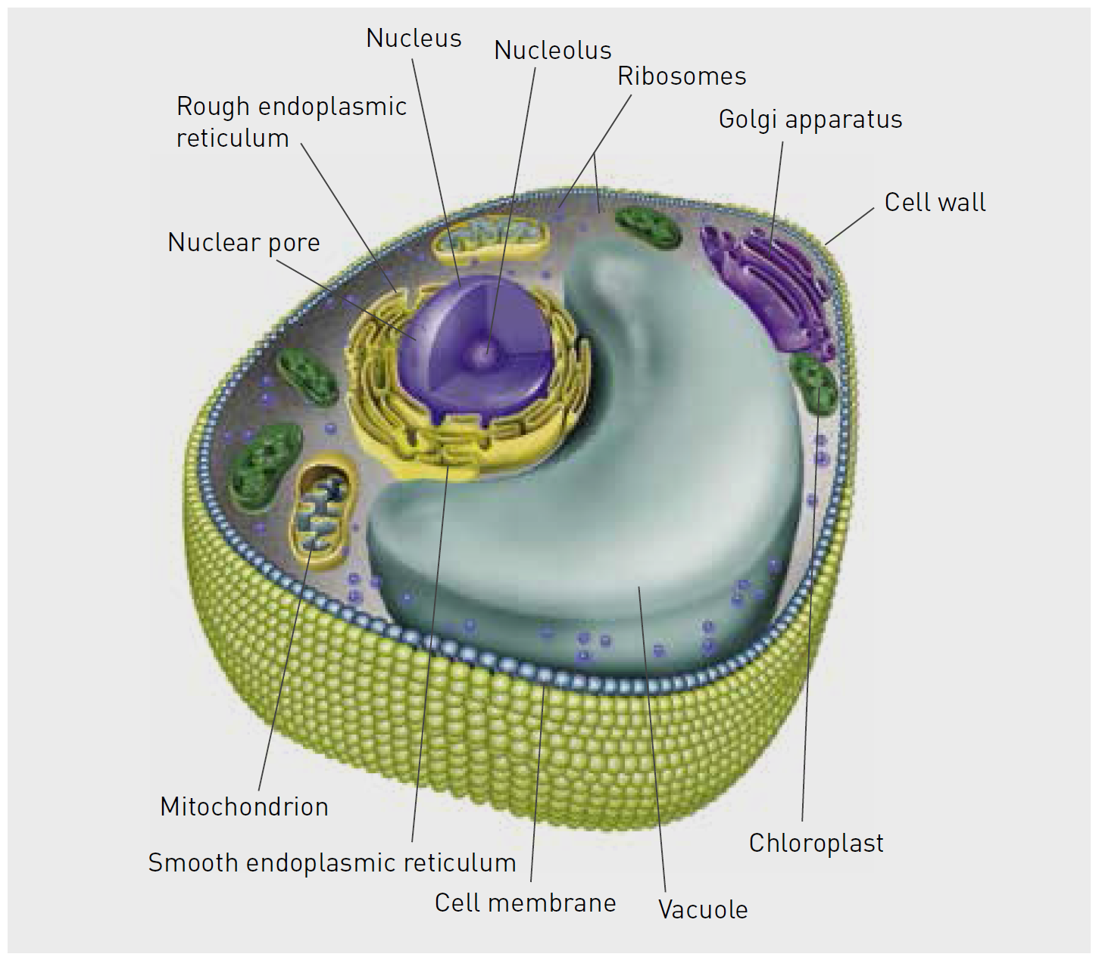
Question 11
Notes:
Plant cell

Slide 10
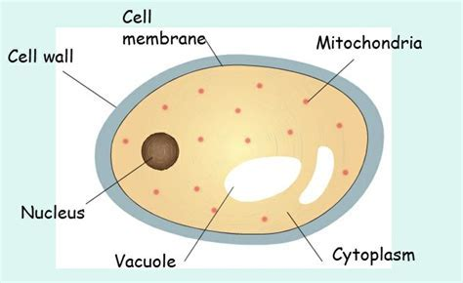
Question 12 & 13
Fungi have a cell wall, however, do not have chloroplasts.
This means they can not make their own food.
Notes:
Plant cell

Slide 11
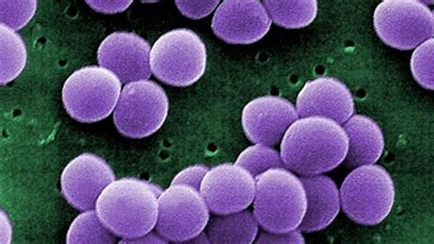
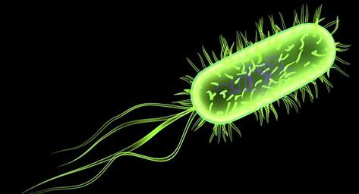
Question 14
Prokaryotic Cells
Prokaryotic cells are the most primitive cellular forms on Earth.
They only possess a few organelles. They do not usually have a nucleus (their DNA is in the cytoplasm).
Bacteria are an example of unicellular organisms.
Vocabulary
uni means one organism means a living thing.

Slide 12
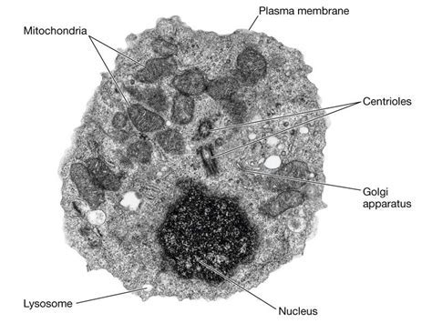
Question 14
Eukaryotic Cells
Eukaryotic cells are more complex than prokaryotic cells.
They can be unicellular or create multicellular organisms.
Eukaryotic cells contain a nucleus and many organelles.
Plant cells, fungal cells, and animal cells are all eukaryotic.

Slide 13
Concept Development
CFU 1
What does the word multi mean?
Multicellular Organisms
Other living things such as humans, fish, trees, and koalas are made of millions of cells. They are called multicellular organisms—multi means many.
In multicellular organisms, all the cells work together but they do not all do the same thing.
The cells in multicellular organisms are specialised. This means that they have a special job to do in the body, and they have a structure that makes them better able to do their job.
CFU 2
How are different body cells specialised?

Slide 14
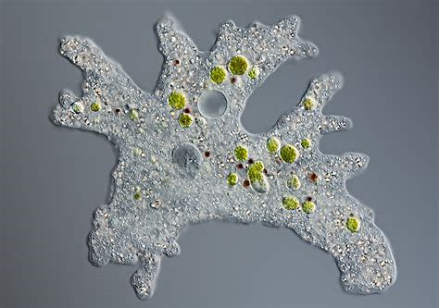
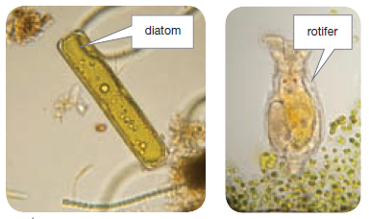
Question 15
CFU 1
Where does the word unicellular come from?
Unicellular Organisms
Many of the living things on Earth are made up of only one eukaryotic cell. This single cell has to carry out all the functions of life.
Living things that are made up of only one cell are known as unicellular organisms.
These living things are too small to be seen with the naked eye.
CFU 2
Name an example of a unicellular organism.

Slide 15
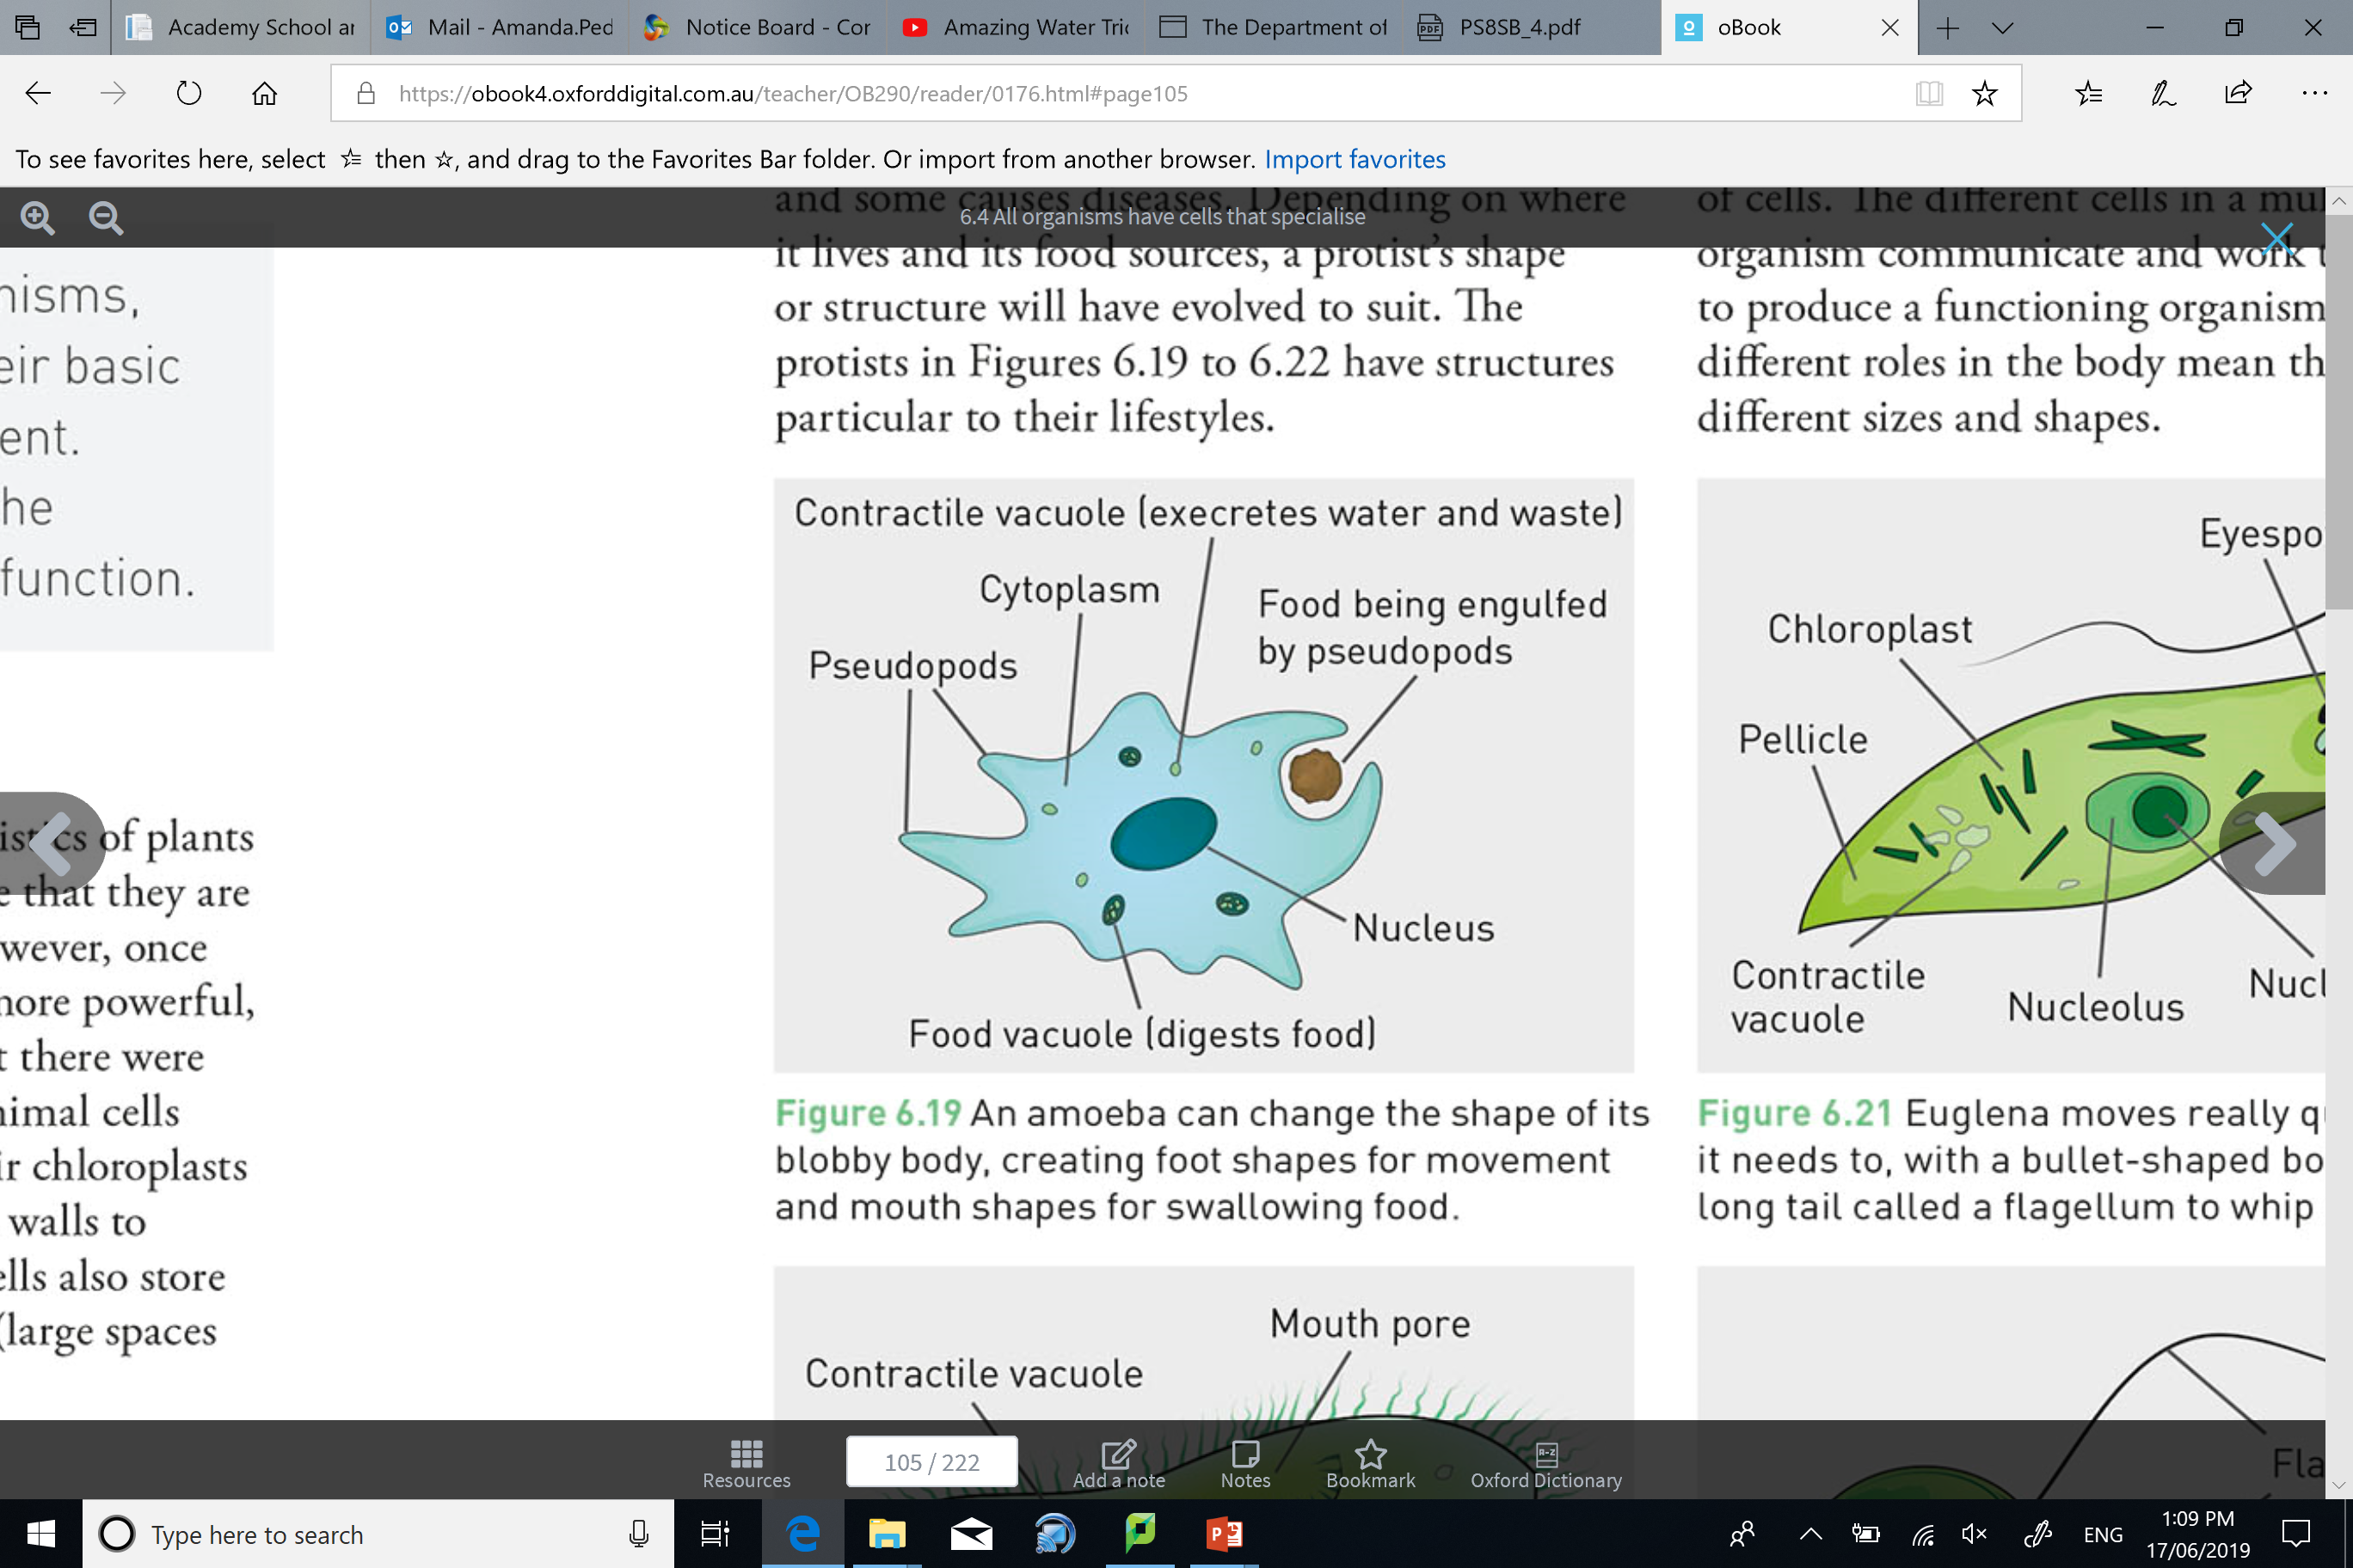
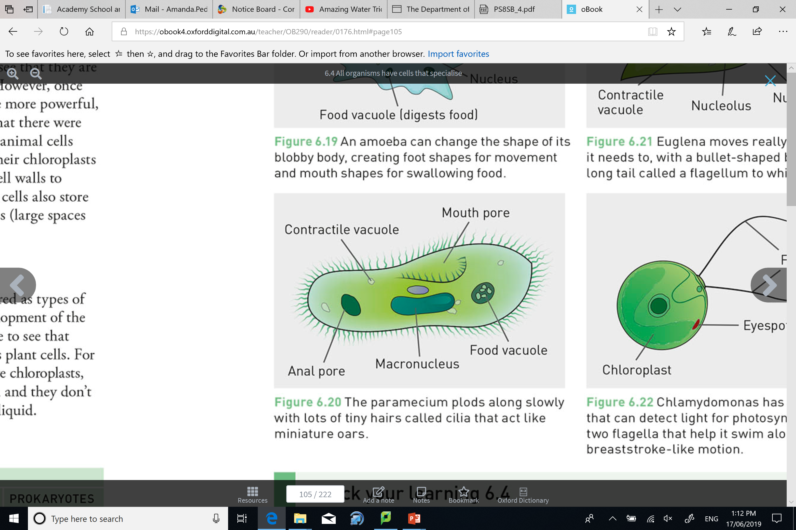
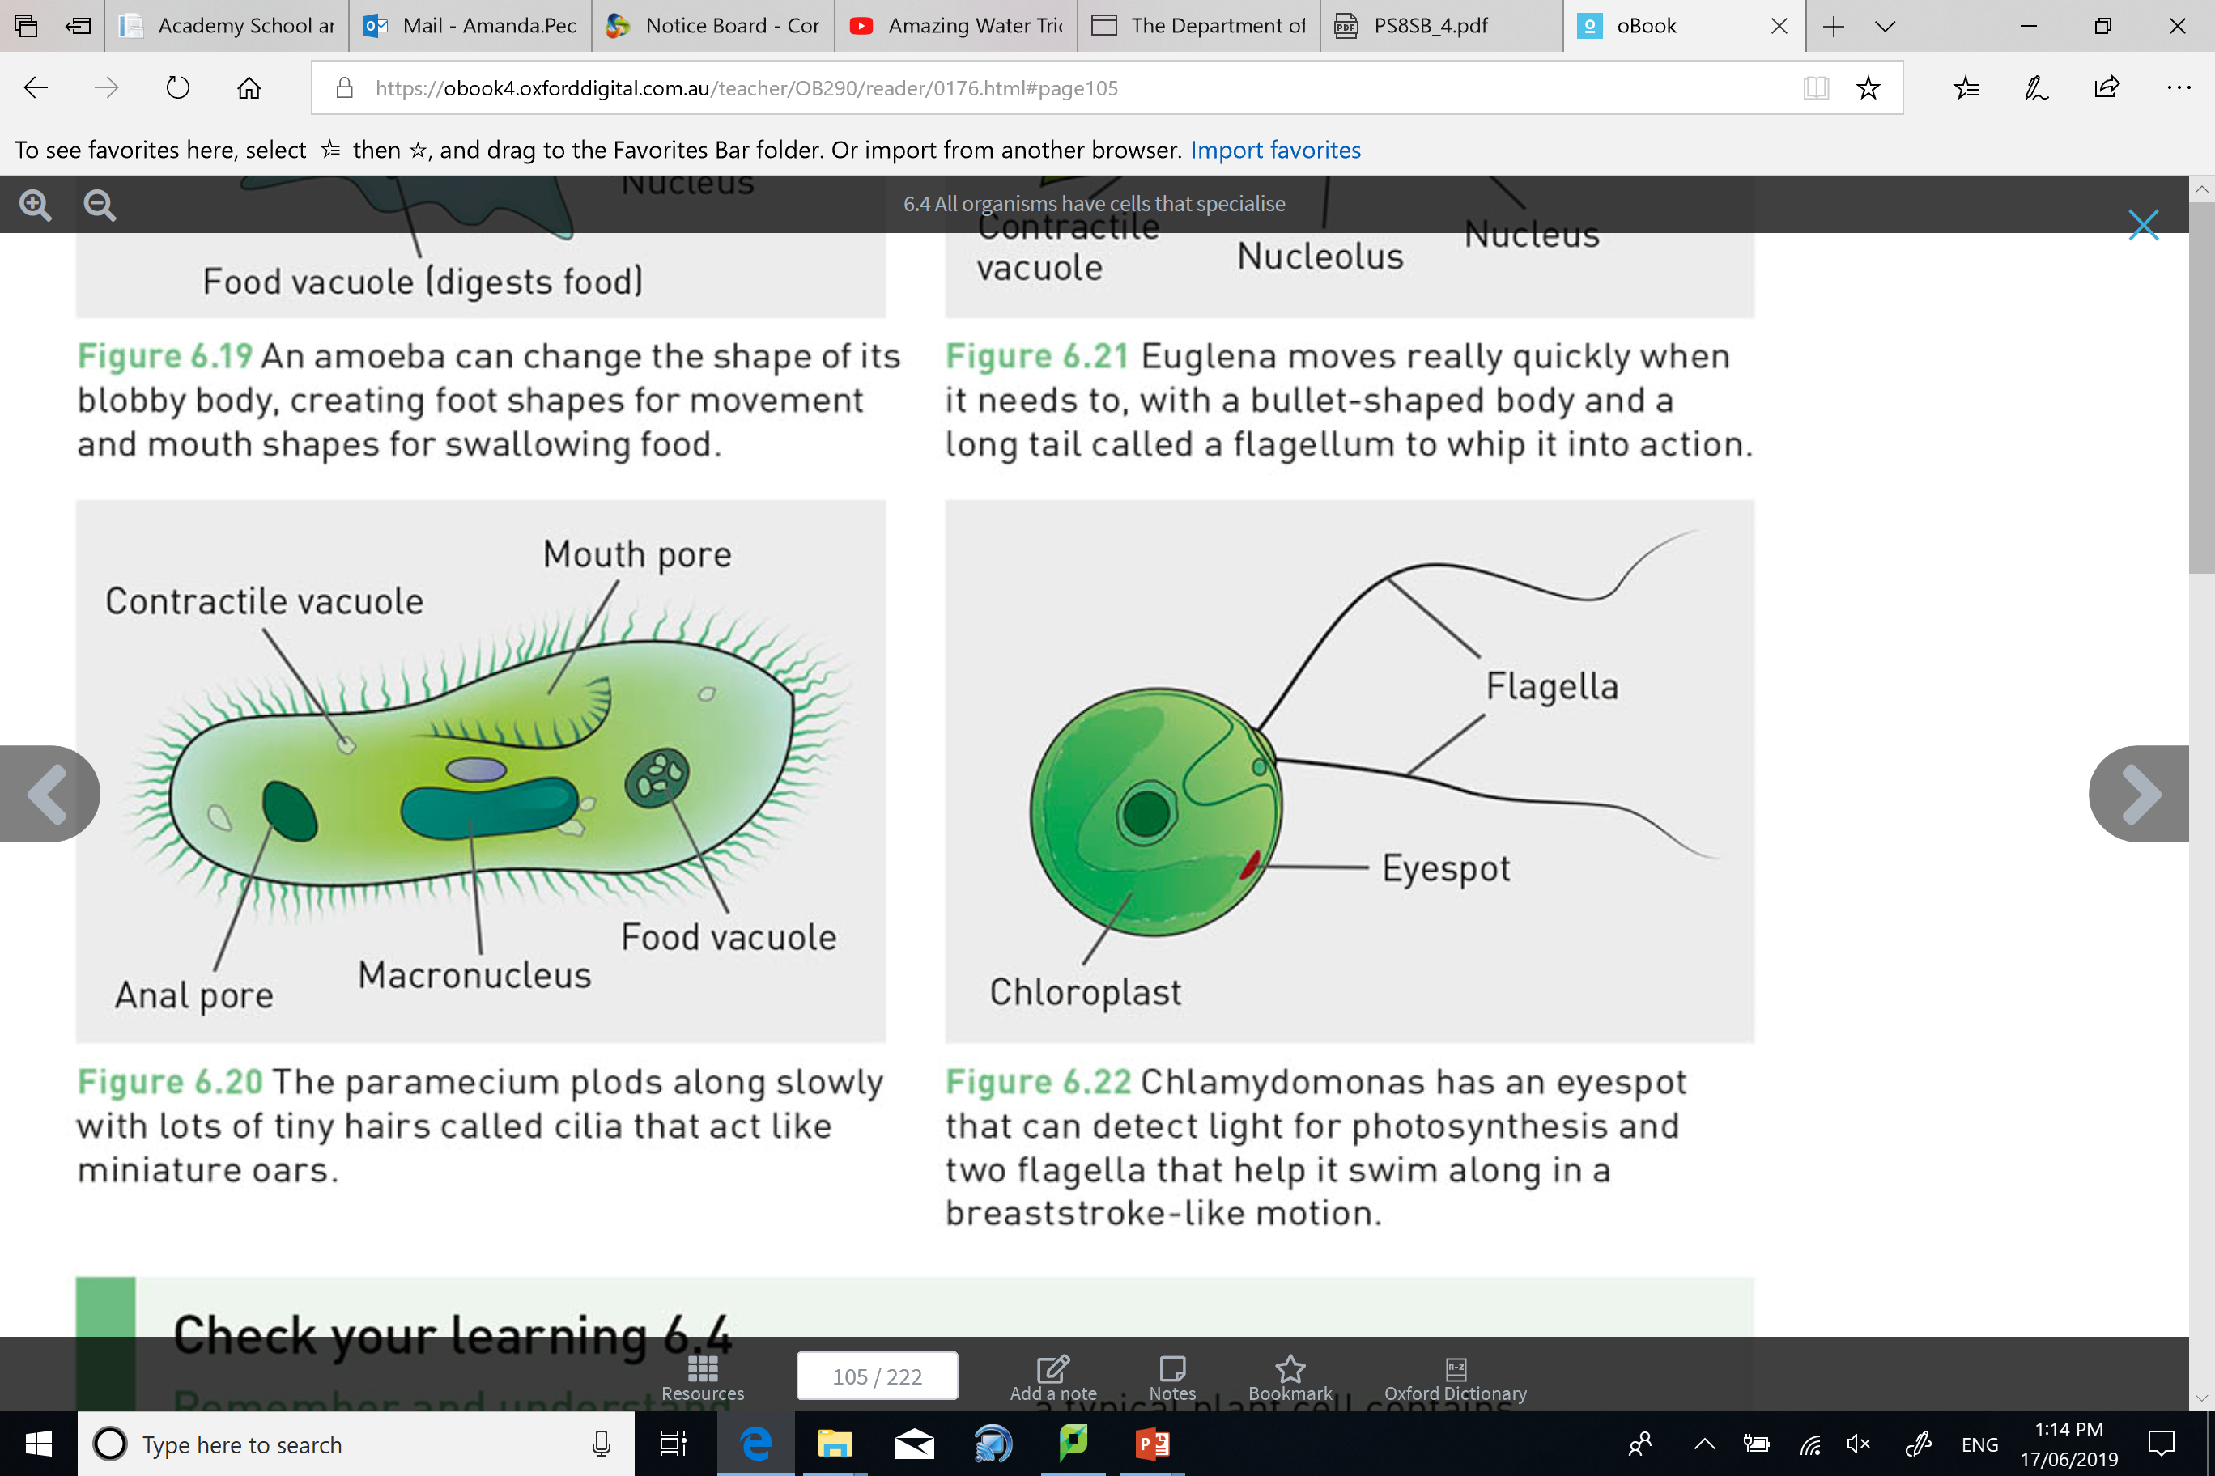
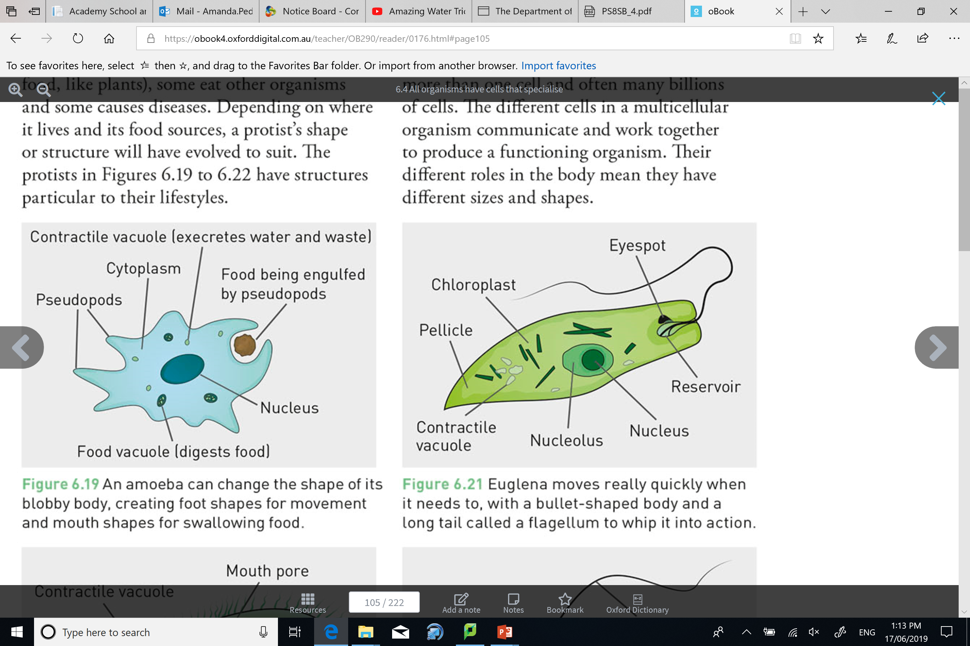
Question 16
Unicellular Structure
Many unicellular organisms will have cells that are structured according to their lifestyles.
An amoeba can change its body shape to create ‘feet’ for movement and a ‘mouth’ for swallowing food.
A paramecium is lined with tiny hairs (cilia) that help it move through fluid.
A euglena has a bullet-shaped body as well as a long tail called a flagellum to increase its speed.
Chlamydomonas has an eyespot that can detect light for photosynthesis, and two flagella to help it swim.

Slide 16
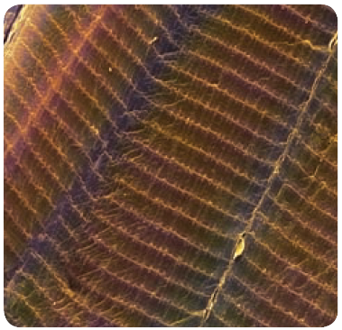
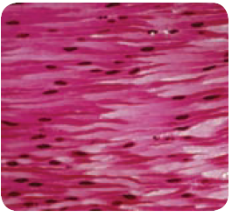
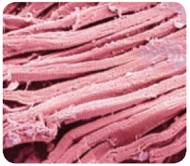
Question 17
Muscle Cells (myocytes)
All muscle cells contain a large number of mitochondria.
They are long and tubular, helping them to contract and relax.
The three types of muscles in your body are:
voluntary muscles (skeletal muscles) move the bones of the skeleton
involuntary muscles (smooth muscles) help our internal organs carry out functions such as breathing and digestion
cardiac muscles (heart muscles) allow the heart to beat continuously
Cardiac muscle does not get tired. It has very large numbers of mitochondria to provide a continuous supply of energy. These characteristics allow the heart to beat continuously.

Slide 17
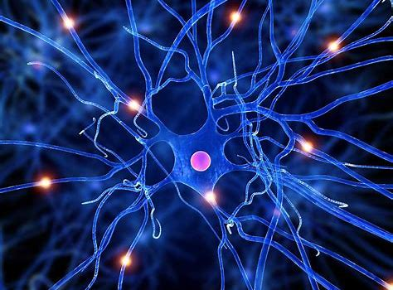
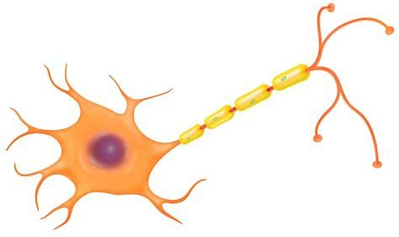
Review
Question 17
Nerve Cells (neurones)
Nerve cells make up the brain, and carry information from the brain to other parts of the body.
The nerve cells are insulated to allow messages to pass along them very quickly.
Some nerve cells have very long fibres called axons extending from the cell. These allow the cell to carry messages over long distances.
The longest axon of a human nerve cell reaches from the base of the spine to the toes, and can be over a metre long.

Slide 18
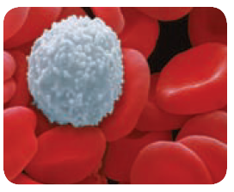
Review
Question 17
Red Blood Cells (erythrocytes)
Red blood cells carry oxygen from the lungs around to the cells of the body where it is used to release energy.
They contain haemoglobin to help them carry oxygen.
Red blood cells also carry some carbon dioxide from the cells back to the lungs.
These cells only survive for 120 days.
Red blood cells have no nucleus, and are a specialised shape (biconcave) to help them carry oxygen.
Vocabulary
Haemo relates to blood Globin relates to globular

Slide 19
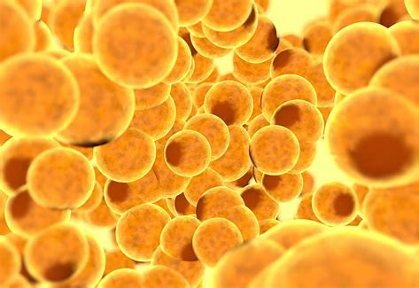
Review
Question 17
Fat Cells (adipocytes)
Fat cells have a flattened nucleus, and can expand easily to allow more fat to be stored.
Brown fat cells are used to produce heat for the body, especially when it gets cold and you are shivering.
White fat cells are used as a store of energy obtained from our food.
They also form an insulating layer under the skin that helps to keep the body at a constant temperature.

Slide 20
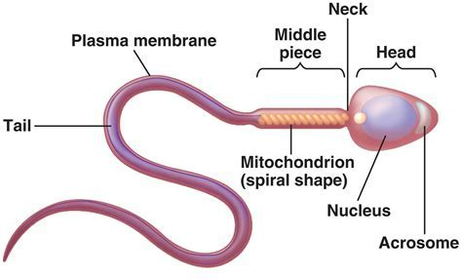
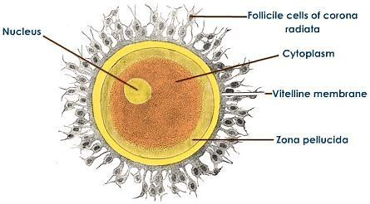
Review
Question 17
Reproductive Cells (sperm and ova)
Sperm and eggs (ova) are cells that contain half the amount of DNA of a normal cell.
They are involved in reproduction.
When the sperm reaches the ovum, fertilisation occurs to create a new organism.
The ovum contains a large amount of cytoplasm to provide the new organism with nutrients.

